Slide 1

OPERATING SYSTEM
ADITYA COLLEGE OF ENGINEERING &
TECHNOLOGY
(process scheduling)
(Unit-2)

Slide 2
Contents
Aditya College of Engineering &
Technology
Process Scheduling
Why do we need scheduling?
When does scheduling happen?
What is CPU Scheduling?
Types of CPU Scheduling?
Types of Schedulers
Scheduling Queues
Scheduling Criteria
Objectives of process scheduling algorithms

Slide 3
Aditya College of Engineering &
Technology
Scheduling Algorithms
First-Come, First-Served (FCFS) Scheduling
Shortest-Job-Next (SJN) Scheduling
Shortest Remaining Time Next (SRTN)
Round Robin(RR) Scheduling
Priority Scheduling
Multiple-Level Queues Scheduling
Multiple-Level Feedback Queue Scheduling

Slide 4
Aditya College of Engineering &
Technology
Process Scheduling

Slide 5
Why do we need scheduling?
Aditya College of Engineering &
Technology
A typical process involves both I/O time and CPU time.
In a uni-programming system like MS-DOS, time spent waiting for I/O is wasted and CPU is free during this time.
Main Objective of multiprogramming is to keep on running processes all the time for maximum utilization of CPU.
Scheduling is fundamental function of OS
In multi programming systems, one process can use CPU while another is waiting for I/O. This is possible only with process scheduling.
The task of selecting the process in memory that are ready to execute and allocating them to the CPU is performed by the CPU Scheduler.

Slide 6
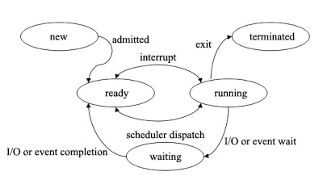
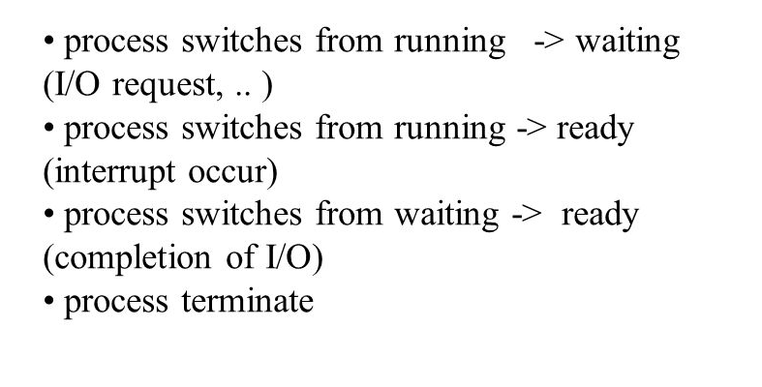
When does Scheduling Happen?
Aditya College of Engineering &
Technology
Four Cases

Slide 7
What is CPU Scheduling?
Aditya College of Engineering &
Technology
CPU scheduling is a process which allows one process to use the CPU while the execution of another process is on hold(in waiting state) due to unavailability of any resource like I/O etc, thereby making full use of CPU.
The aim of CPU scheduling is to make the system efficient, fast and fair.
Whenever the CPU becomes idle, the operating system must select one of the processes in the ready queue to be executed.
The selection process is carried out by the short-term scheduler (or CPU scheduler, running in the dispatcher).
The scheduler selects from among the processes in memory that are ready to execute, and allocates the CPU to one of them.

Slide 8
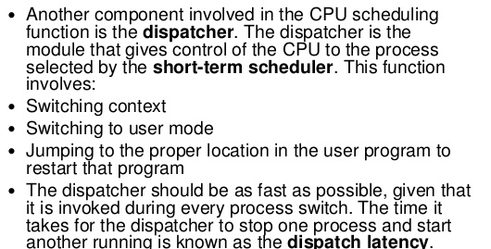
Dispatcher
Aditya College of Engineering &
Technology

Slide 9
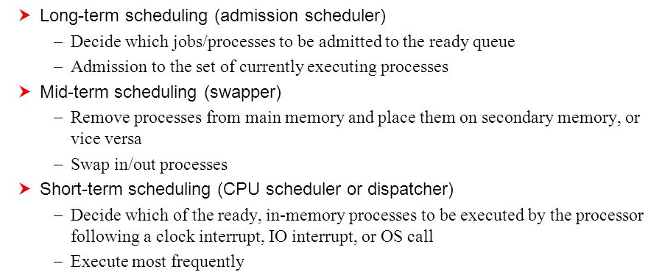
Types of scheduling
Aditya College of Engineering &
Technology

Slide 10
Process Schedulers
Aditya College of Engineering &
Technology
1. Long term scheduler
It is also known as job scheduler. It chooses the processes from the pool (secondary memory) and keeps them in the ready queue maintained in the primary memory.
2. Short term scheduler
It is also known as CPU scheduler. It selects one of the Jobs from the ready queue and dispatch to the CPU for the execution.
3. Medium term scheduler
It is also known as Swapper. It takes care of the swapped out processes. If the running state processes needs some IO time for the completion then there is a need to change its state from running to waiting.

Slide 11
Scheduling Queues
Aditya College of Engineering &
Technology
1. Job Queue
Initially, all the processes get stored in the job queue. It is maintained in the secondary memory. The long term scheduler (Job scheduler) picks some of the jobs and put them in the primary memory.
2. Ready Queue
Ready queue is maintained in primary memory. The short term scheduler picks the job from the ready queue and dispatch to the CPU for the execution.
3. Waiting Queue
When the process needs some IO operation in order to complete its execution, OS changes the state of the process from running to waiting. The context (PCB) associated with the process gets stored on the waiting queue which will be used by the Processor when the process finishes the IO.

Slide 12
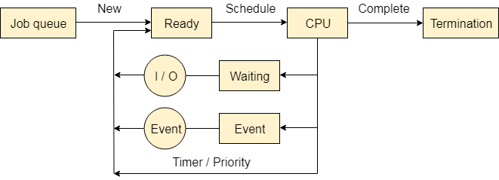
The following queues maintained by the Operating system
Aditya College of Engineering &
Technology

Slide 13
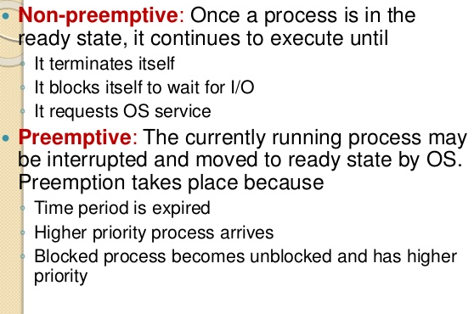
Types of CPU Scheduling
Aditya College of Engineering &
Technology

Slide 14
Context Switching
Aditya College of Engineering &
Technology
Whenever the running process requests some IO operation then the short term scheduler saves the current context of the process (also called PCB) and changes its state from running to waiting.
During the time, process is in waiting state, the Short term scheduler picks another process from the ready queue and assigns the CPU to this process. This procedure is called context switching.
Operating system maintains a process control block during the lifetime of the process.
The Process control block is deleted when the process is terminated or killed.

Slide 15
Scheduling Criteria
Aditya College of Engineering &
Technology
CPU Utilization
CPU would be working most of the time(Ideally 100% of the time).
Throughput
It is the total number of processes completed per unit time.
Turnaround Time
It is the amount of time taken to execute a particular process, i.e. The interval from time of submission of the process to the time of completion of the process.
Waiting Time
The amount of time a process has been waiting in the ready queue to acquire get control on the CPU.
Response Time
Amount of time it takes from when a request was submitted until the first response is produced.

Slide 16
Objectives of Process Scheduling Algorithm
Aditya College of Engineering &
Technology
Max CPU utilization [Keep CPU as busy as possible]
Fair allocation of CPU.
Max throughput [Number of processes that complete their execution per time unit]
Min turnaround time [Time taken by a process to finish execution]
Min waiting time [Time a process waits in ready queue]
Min response time [Time when a process produces first response]

Slide 17
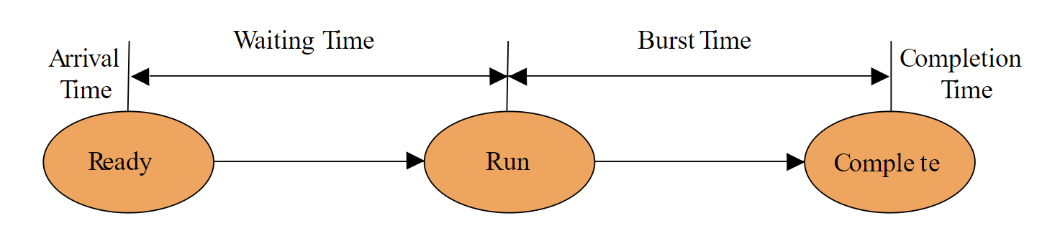
Various Times related to the Process
Aditya College of Engineering &
Technology
Arrival Time
Completion Time
Burst Time
Turn Around Time-----ct-at
Waiting Time
Response Time
P1—0ms-----5ms
P2---2ms----8ms
P3---4ms---12ms

Slide 18
Aditya College of Engineering &
Technology
Arrival Time: Time at which the process arrives in the ready queue.
Completion Time: Time at which process completes its execution.
Burst Time: Time required by a process for CPU execution.
Turn Around Time: Time Difference between completion time and arrival time. Turn Around Time = Completion Time – Arrival Time
Waiting Time(W.T): Time Difference between turn around time and burst time. Waiting Time = Turn Around Time – Burst Time
Response Time: The difference between the arrival time and the time at which the process first gets the CPU is called Response Time.

Slide 19
Scheduling Algorithms
Aditya College of Engineering &
Technology
First-Come, First-Served (FCFS) Scheduling
Shortest-Job-Next (SJN or SJF) Scheduling
Shortest Remaining Time Next (SRTN)
Round Robin(RR) Scheduling
Priority Scheduling
Multi-Level Queues Scheduling
Multi-Level Feedback Queue Scheduling

Slide 20
First Come First Serve Scheduling
Aditya College of Engineering &
Technology
"First Come First Serve" scheduling algorithm, as the name suggests, the process which arrives first, gets executed first,
or
we can say that the process which requests the CPU first, gets the CPU allocated first.
First Come First Serve, is just like FIFO(First in First out) Queue data structure.
This is used in Batch Systems.
FCFS is a non-preemptive scheduling algorithm.
A perfect real life example of FCFS scheduling is buying tickets at ticket counter.

Slide 21
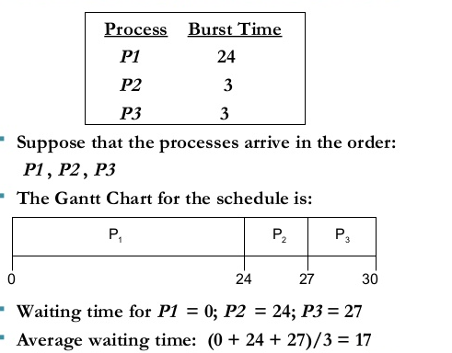
FCFS Example1
Aditya College of Engineering &
Technology
TAT
P1->24-0=24
P2→27-0=27
P3->30-0=30
ATAT=27ms
What is turn around time?
What is response time?

Slide 22
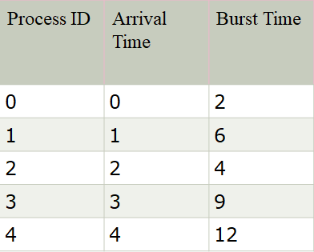

FCFS Example2
Sol: Gantt Chart
WT
P0=0-0=0ms
P1=2-1=1ms
P2=8-2=6ms
P3=12-3=9ms
P4=21-4=17ms
AWT=33/5=6.6ms
TAT
P0=2-0=2ms
P1=8-1=7ms
P2=12-2=10ms
P3=21-3=18ms
P4=33-4=29ms
ATAT=66/5=13.2ms
RT
P0=0-0=0ms
P1=2-1=1ms
P2=8-2=6ms
P3=12-3=9ms
P4=21-4=17ms
ART=33/5=6.6ms

Slide 23
FCFS Example2
Process ID | Arrival Time | Burst Time | Completion Time | Turn Around Time | Waiting Time
0 | 0 | 2 | 2 | 2 | 0
1 | 1 | 6 | 8 | 7 | 1
2 | 2 | 4 | 12 | 10 | 6
3 | 3 | 9 | 21 | 18 | 9
4 | 4 | 12 | 33 | 29 | 17
ATAT=66/5=13.2ms
AWT=33/5=6.6ms
Gantt Chart
TAT = CT-AT
WT = TAT-BT

Slide 24
Advantages
Aditya College of Engineering &
Technology
FCFS algorithm doesn't include any complex logic, it just puts the process requests in a queue and executes it one by one.
FCFS is simple and easy to implement.
Eventually, every process will get a chance to run, so starvation doesn't occur.

Slide 25
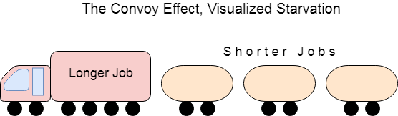
Disadvantages
Aditya College of Engineering &
Technology
It is Non Pre-emptive algorithm, which means the process priority doesn't matter.
Not optimal Average Waiting Time.
Resources utilization in parallel is not possible, which leads to Convoy Effect, and hence poor resource(CPU, I/O etc) utilization.
Convoy Effect is a situation where many processes, who need to use a resource for short time are blocked by one process holding that resource for a long time.
This essentially leads to poor utilization of resources and hence poor performance.

Slide 26
Shortest Job First(SJF) Scheduling
Aditya College of Engineering &
Technology
This is also known as shortest job Next, or SJN
Process which have the shortest burst time are scheduled first.
If two processes have the same bust time then FCFS is used to break the tie.
This is either non-preemptive or pre-emptive scheduling algorithm.
Best approach to minimize waiting time.
Easy to implement in Batch systems where required CPU time is known in advance.
Impossible to implement in interactive systems where required CPU time is not known.
The processor should know in advance how much time process will take.

Slide 27
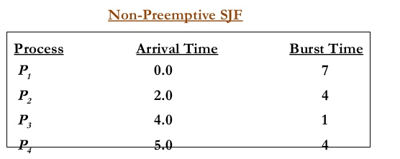
SJF Example 1
Aditya College of Engineering &
Technology

Slide 28
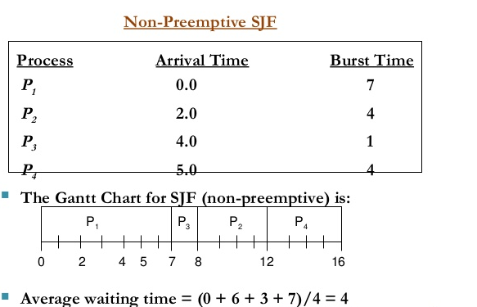
SJF Example 1
Aditya College of Engineering &
Technology

Slide 29
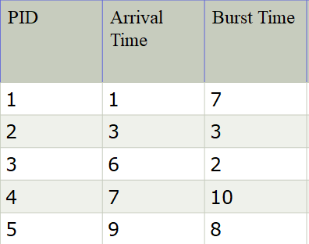
SJF Example 2
In the following example, there are five jobs named as P1, P2, P3, P4 and P5. Their arrival time and burst time are given in the table below.

Slide 30
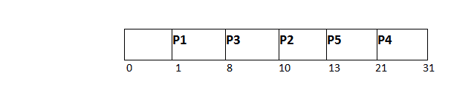
SJF Example 2
PID | Arrival Time | Burst Time | Completion Time | Turn Around Time | Waiting Time
1 | 1 | 7 | 8 | 7 | 0
2 | 3 | 3 | 13 | 10 | 7
3 | 6 | 2 | 10 | 4 | 2
4 | 7 | 10 | 31 | 24 | 14
5 | 9 | 8 | 21 | 12 | 4
Gantt Chart
Avg Waiting Time = 27/5

Slide 31
Shortest Remaining Time Next(SRTN)
Aditya College of Engineering &
Technology
Shortest remaining time (SRT) is the preemptive version of the SJN algorithm.
The processor is allocated to the job closest to completion but it can be preempted by a newer ready job with shorter time to completion.
Impossible to implement in interactive systems where required CPU time is not known.
It is often used in batch environments where short jobs need to give preference.

Slide 32
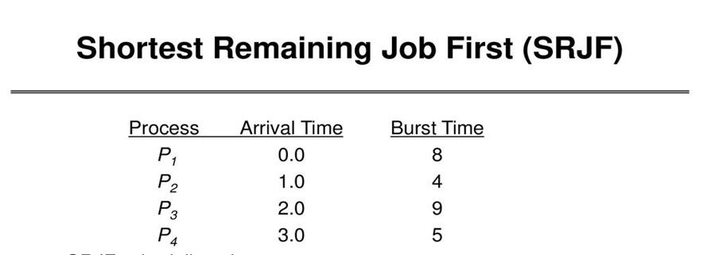
SRTN Example 1
Aditya College of Engineering &
Technology

Slide 33
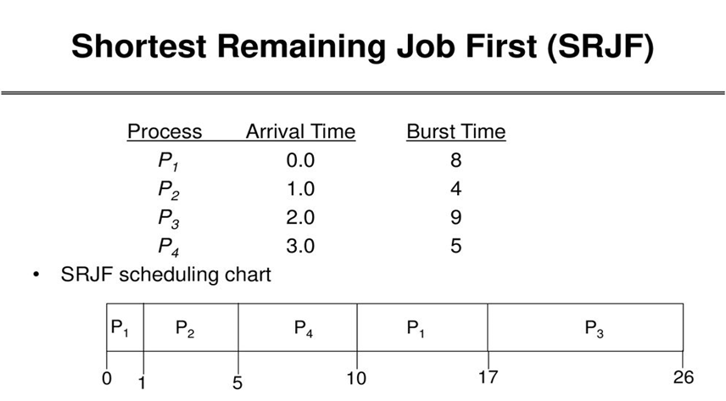
Aditya College of Engineering &
Technology
RT
P1=0-0=0ms
P2=1-1=0ms
P3=17-2=15ms
P4=5-3=2ms
ART=17/4=4.2ms
WT
P1=9ms
P2=1-1=0
P3=17-2=15
P4=5-3=2
Tat
P1=17-0=17
P2=5-1=4
P3=26-2=24
P4=10-3=7
Atat=52/4=13ms
AWT=(9+0+15+2)/4=6.5ms

Slide 34
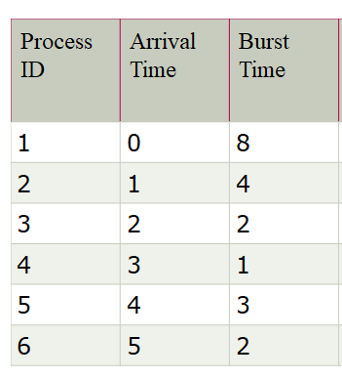
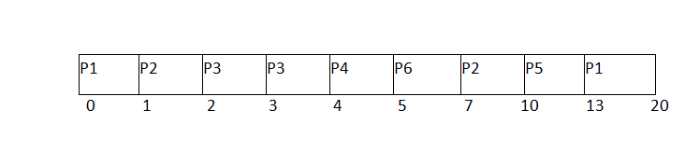
SRTN Example 2
Aditya College of Engineering &
Technology
P1=0-0=0
P2=1-1=0
P3=2-2=0
P4=4-3=1
P5=10-4=6
P6=5-5=0

Slide 35
SRTN Example 2
Aditya College of Engineering &
Technology
Process ID | Arrival Time | Burst Time | Completion Time | Turn Around Time | Waiting Time | Response Time
1 | 0 | 8 | 20 | 20 | 12 | 0
2 | 1 | 4 | 10 | 9 | 5 | 0
3 | 2 | 2 | 4 | 2 | 0 | 0
4 | 3 | 1 | 5 | 2 | 1 | 1
5 | 4 | 3 | 13 | 9 | 6 | 6
6 | 5 | 2 | 7 | 2 | 0 | 0
AtAt=44/6=7.33ms
Awt=24/6=4ms
aRt=7/6=1.66

Slide 36
SRTN Example 2
Aditya College of Engineering &
Technology
Gantt Chart
Avg Waiting Time = 24/6

Slide 37
Aditya College of Engineering &
Technology
Advantages:
Maximum throughput
Minimum average waiting and turnaround time
Disadvantages:
The time taken by a process must be known by the CPU beforehand, which is not possible.
Longer processes will have more waiting time, eventually they'll suffer starvation.

Slide 38
Round Robin Scheduling
Aditya College of Engineering &
Technology
This is the preemptive version of first come first serve scheduling.
The Algorithm focuses on Time Sharing.
In this algorithm, every process gets executed in a cyclic way.
A certain time slice is defined in the system which is called time quantum.
Each process present in the ready queue is assigned the CPU for that time quantum, if the execution of the process is completed during that time then the process will terminate else the process will go back to the ready queue and waits for the next turn to complete the execution.
Context switching is used to save states of preempted processes.

Slide 39
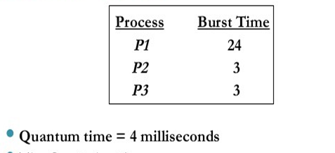
Round Robin Scheduling example
Aditya College of Engineering &
Technology

Slide 40
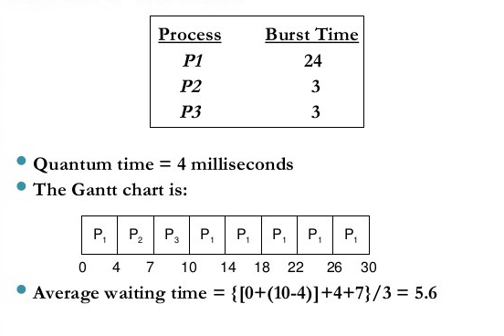
Round Robin Scheduling example
Aditya College of Engineering &
Technology
WT
P1=0+3+3=6ms
P2=4ms
P3=7
AWT=17/3=5.6ms
Tat
P1=30
P2=7
P3=10
Atat=47/3=15.6ms
RT
P1=0
P2=4
P3=7
ART=11/3=3.6

Slide 41
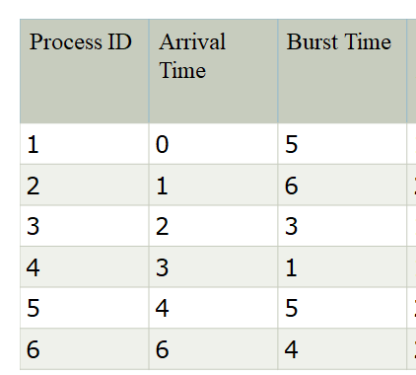
Aditya College of Engineering &
Technology
RR Scheduling example2 time quantum = 4 units
WT
P1=0+16=16ms
P2=4+13=17-1=16ms
P3=8-2=6ms
P4=11-3=8ms
P5=12+7-4=15ms
P6=16-6=10ms
AWT=71/6=11.83ms
1. P1 P2 P3 P4 P5 P6 P1 P2 P5
RT
p1=0-0=0ms
P2=4-1=3ms
P3=8-2=6ms
P4=11-3=8ms
P5=12-4=8ms
P6=16-6=10ms
ART=35/6=5.83ms
1
2
0
TAT
P1=21-0=21ms
P2=23-1=22ms
P3=11-2=9ms
P4=12-3=9ms
P5=24-4=20ms
P6=20-6=14ms
ATAT=95/6=15.83
0
1

Slide 42
RR Scheduling example2 time quantum = 4 units
Process ID | Arrival Time | Burst Time | Completion Time | Turn Around Time | Waiting Time
1 | 0 | 5 | 17 | 17 | 12
2 | 1 | 6 | 23 | 22 | 16
3 | 2 | 3 | 11 | 9 | 6
4 | 3 | 1 | 12 | 9 | 8
5 | 4 | 5 | 24 | 20 | 15
6 | 6 | 4 | 21 | 15 | 11

Slide 43
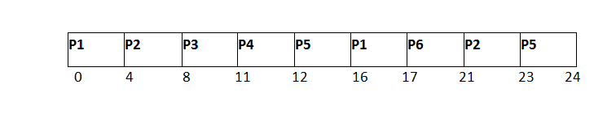
Avg Waiting Time = (12+16+6+8+15+11)/6 = 76/6 units
Gantt Chart

Slide 44
RR Scheduling
Aditya College of Engineering &
Technology
Advantages
It can be actually implementable in the system because it is not depending on the burst time.
It doesn't suffer from the problem of starvation or convoy effect.
All the jobs get a fare allocation of CPU.
Disadvantages
The higher the time quantum, the higher the response time in the system.
The lower the time quantum, the higher the context switching overhead in the system.
Deciding a perfect time quantum is really a very difficult task in the system.

Slide 45
Priority Based Scheduling
Aditya College of Engineering &
Technology
Each process is assigned a priority.
Process with highest priority (Smallest integer= highest priority) is to be executed first and so on.
Processes with same priority are executed on first come first served basis.
Priority can be decided based on memory requirements, time requirements or any other resource requirement.
Prioritize admin jobs is the best example.
Problem: Starvation - low priority processes may never execute.
Solution: Aging - As time progresses increases the priority of the process

Slide 46
Types of Priority Scheduling Algorithm
Aditya College of Engineering &
Technology
Preemptive Priority Scheduling: If the new process arrived at the ready queue has a higher priority than the currently running process, the CPU is preempted, which means the processing of the current process is stopped and the incoming new process with higher priority gets the CPU for its execution.
Non-Preemptive Priority Scheduling: If a new process arrives with a higher priority than the current running process, the incoming process is put at the head of the ready queue, which means after the execution of the current process it will be processed.

Slide 47
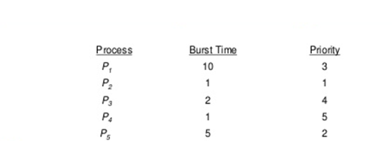
Non-Preemptive Priority Scheduling
Aditya College of Engineering &
Technology

Slide 48
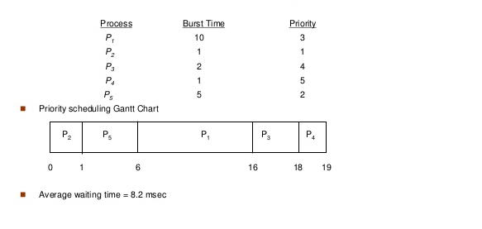
Non-Preemptive Priority Scheduling
Aditya College of Engineering &
Technology
WT
P1=6
P2=0
P3=16
P4=18
P5=1
AWT=41/5=8.2 ms
TAT
P1=16
P2=1
P3=18
P4=19
P5=6
ATAT=60/5=12ms

Slide 49
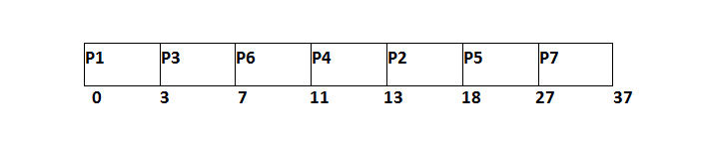
Example2
Aditya College of Engineering &
Technology
WT
P1=0-0=0
P2=13-2=11
P3=3-1=2
P4=11-4=7
P5=18-6=12
P6=7-5=2
P7=27-7=20
Awt=54/7=7.7ms
TAT
P1=3-0=3ms
P2=18-2=16
P3=7-1=6
P4=13-4=9
P5=27-6=21
P6=11-5=6
P7=37-7=30
ATAT=91/7=13ms
RT is same as WT

Slide 50
Non-Preemptive Priority Scheduling
Aditya College of Engineering &
Technology
Process Id | Priority | Arrival Time | Burst Time | Completion Time | Turnaround Time | Waiting Time | Response Time
1 | 2 | 0 | 3 | 3 | 3 | 0 | 0
2 | 6 | 2 | 5 | 18 | 16 | 11 | 13
3 | 3 | 1 | 4 | 7 | 6 | 2 | 3
4 | 5 | 4 | 2 | 13 | 9 | 7 | 11
5 | 7 | 6 | 9 | 27 | 21 | 12 | 18
6 | 4 | 5 | 4 | 11 | 6 | 2 | 7
7 | 10 | 7 | 10 | 37 | 30 | 20 | 27

Slide 51
Aditya College of Engineering &
Technology
Gantt Chart
Avg Waiting Time = (0+11+2+7+12+2+18)/7 = 54/7 units

Slide 52
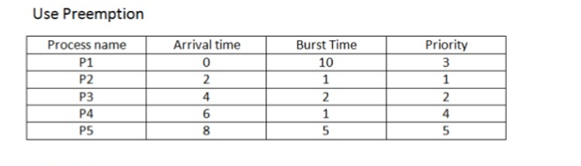
Preemptive Priority Scheduling
Aditya College of Engineering &
Technology

Slide 53
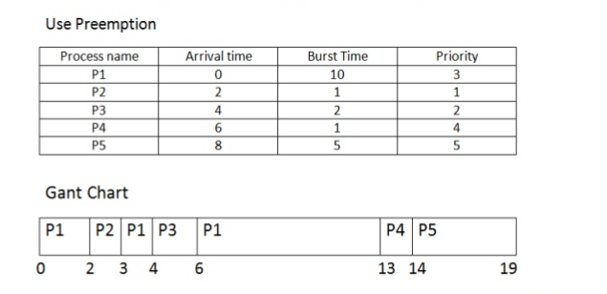
Preemptive Priority Scheduling
Aditya College of Engineering &
Technology
WT p1=0+1+2=3-0=3ms
P2=2-2=0ms
P3=4-4=0ms
P4=13-6=7ms
P5=14-8=6ms
AWT=16/5=3.2ms
8
7
RT
P1=0-0=0
P2=2-2=0
P3=4-4=0
P4=13-6=7
P5=14-8=6
ART=13/5=2.6ms
TAT
P1=13-0=13
P2=3-2=1
P3=6-4=2
P4=14-6=8
P5=19-8=11
ATAT=35/5=7ms

Slide 54
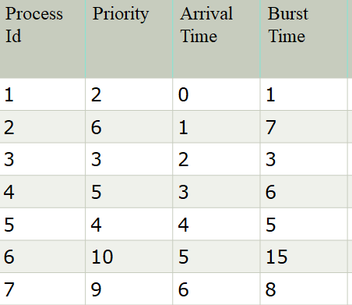
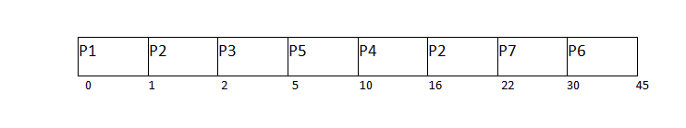
Preemptive Priority Scheduling
Aditya College of Engineering &
Technology
WT
P1=0-0=0
P2=14
P3=2-2=0
P4=10-3=7
P5=5-4=1
P6=30-5=25
P7=22-6=16
AWT=63/7=9ms
RT
P1=0-0=0
P2=1-1=0
P3=2-2=0
P4=10-3=7
P5=5-4=1
P6=30-5=25
P7=22-6=16
ART=49/7=7ms
TAT
P1=1-0=1
P2=22-1=21
P3=5-2=3
P4=16-3=13
P5=10-4=6
P6=45-5=40
P7=30-6=24
ATAT=108/7=15.4ms

Slide 55
Aditya College of Engineering &
Technology
Avg Waiting Time = (0+14+0+7+1+25+16)/7 = 63/7 = 9 units
Gantt Chart

Slide 56
Preemptive Priority Scheduling
Aditya College of Engineering &
Technology
Process Id | Priority | Arrival Time | Burst Time | Completion Time | Turn around Time | Waiting Time
1 | 2 | 0 | 1 | 1 | 1 | 0
2 | 6 | 1 | 7 | 22 | 21 | 14
3 | 3 | 2 | 3 | 5 | 3 | 0
4 | 5 | 3 | 6 | 16 | 13 | 7
5 | 4 | 4 | 5 | 10 | 6 | 1
6 | 10 | 5 | 15 | 45 | 40 | 25
7 | 9 | 6 | 8 | 30 | 24 | 16

Slide 57
Multilevel Queue Scheduling
Aditya College of Engineering &
Technology
A multi-level queue scheduling algorithm partitions the ready queue into several separate queues.
The processes are permanently assigned to one queue, generally based on some property of the process, such as memory size, process priority, or process type.
Each queue has its own scheduling algorithm.
For example: separate queues might be used for foreground and background processes.
The foreground queue might be scheduled by Round Robin algorithm, while the background queue is scheduled by an FCFS algorithm.
In addition, there must be scheduling among the queues, which is commonly implemented as fixed-priority preemptive scheduling.
For example: The foreground queue may have absolute priority over the background queue.

Slide 58
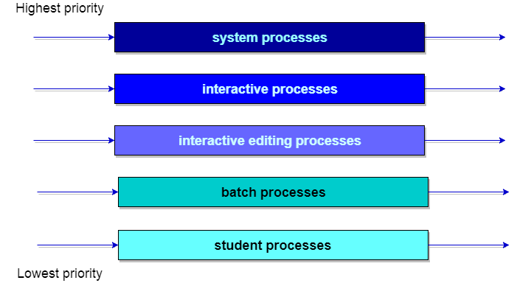
Example: Each queue has absolute priority over lower-priority queues. No process in the batch queue, for example, could run unless the queues for system processes, interactive processes, and interactive editing processes were all empty. If an interactive editing process entered the ready queue while a batch process was running, the batch process will be preempted.
Aditya College of Engineering &
Technology

Slide 59
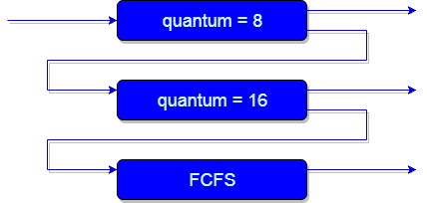
Multilevel Feedback Queue Scheduling
Aditya College of Engineering &
Technology
It allows a process to move between queues.
The idea is to separate processes with different CPU-burst characteristics.
If a process uses too much CPU time, it will be moved to a lower-priority queue. Similarly, a process that waits too long in a lower-priority queue may be moved to a higher-priority queue.
This form of aging prevents starvation.

Slide 60
Aditya College of Engineering &
Technology
multilevel feedback queue scheduler is defined by the following parameters:
The number of queues.
The scheduling algorithm for each queue.
The method used to determine when to upgrade a process to a higher-priority queue.
The method used to determine when to demote a process to a lower-priority queue.
The method used to determine which queue a process will enter when that process needs service.

Slide 61
Different Operations on Processes
Aditya College of Engineering &
Technology
There are many operations that can be performed on processes.
process creation
process preemption
process blocking
process termination

Slide 62
Process Creation
Aditya College of Engineering &
Technology
Processes need to be created in the system for different operations. This can be done by the following events −
User request for process creation
System initialization
Execution of a process creation system call by a running process
Batch job initialization
A process may be created by another process using fork() in unix Environment.
The creating process is called the parent process and the created process is the child process. A child process can have only one parent but a parent process may have many children.
Each of these new processes may in turn create other processes forming a tree of processes.

Slide 63
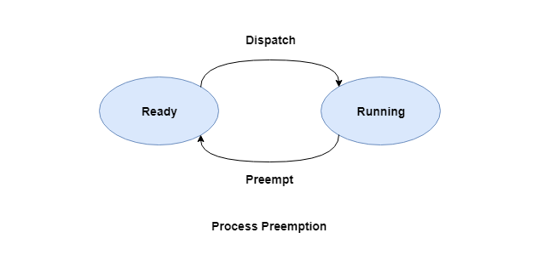
Process Preemption
Aditya College of Engineering &
Technology
An interrupt mechanism is used in preemption that suspends the process executing currently and the next process to execute is determined by the short-term scheduler.
Preemption makes sure that all processes get some CPU time for execution.

Slide 64
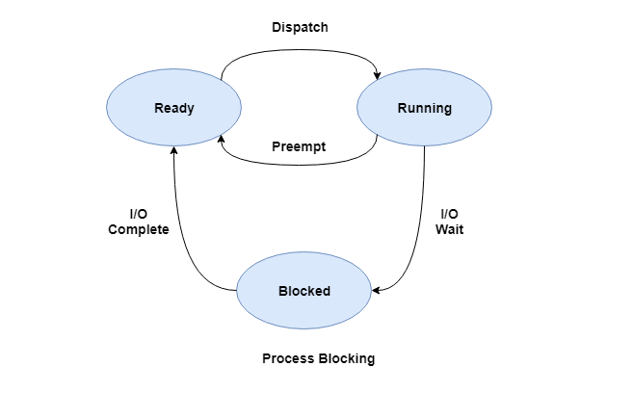
Process Blocking
Aditya College of Engineering &
Technology
The process is blocked if it is waiting for some event to occur.
This event may be I/O as the I/O events are executed in the main memory and don't require the processor.
After the event is complete, the process again goes to the ready state.

Slide 65
Process Termination
Aditya College of Engineering &
Technology
After the process has completed the execution of its last instruction, it is terminated.
The resources held by a process are released after it is terminated.

Slide 66
Aditya College of Engineering &
Technology
THANK YOU

